Slide 1
By Geoff Jonse
Candy
I Like

Slide 2
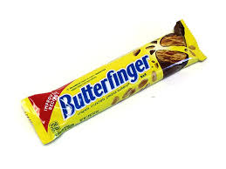
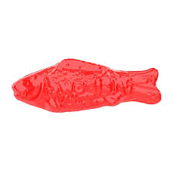
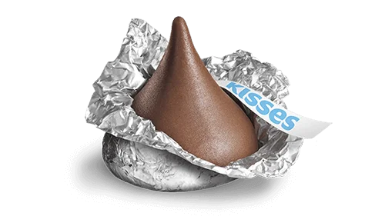
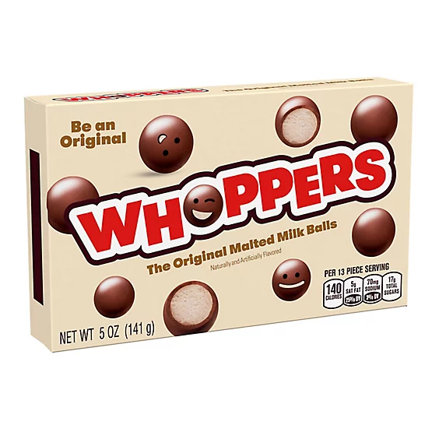
Butterfingers
Swedish Fish
Hershey Kiss
Whoppers

Slide 3
THANK YOU!!!
:)

